Slide 1
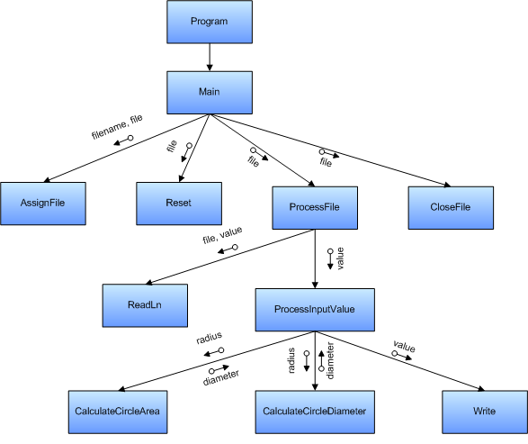
Passing data to (and from) functions
Notes:
Introduction
Welcome. In this presentation we are going to look at some of the different ways that we can pass data between routines in our programs. We have already seen parameter passing, now we can looking at some additional features of parameter passing.

Slide 2
Parameter passing can be performed in a variety of ways
Notes:
A world of opportunity
While we have looked at one of the ways of passing data between routines, there are several others. As developers you will need to be able to make the most of these mechanisms as they will simplify certain problems. Being able to use these different options will help in these cases.

Slide 3
Master these three parameter passing mechanisms
Value
Return
Pointer
Variable
Notes:
Three parameter passing mechanisms
The three parameter passing mechanisms that you need to master are:
Value parameters: these are the default parameter passing options. Here the value of the argument is copied into the value of the parameter.
Out parameters: these allow the value of the argument to be set within the called routine, as done by the ReadLn routine.
Variable parameters: these provide a mix of features from both value and out parameters. With variable parameters, the argument provides an initial value for the parameter while also being able to be set within the routine.
Lets examine these in more detail now.

Slide 4
Value parameters allow data to be passed into the routine
Calling
Routine
Called
Routine
Notes:
Passing in a copy
Value parameters are the default parameter passing mechanism. Using this mechanism the value of the argument is copied and passed to the parameter when the routine is called. You will find that most parameter passing will be of this type.

Slide 5
Most parameters are value parameters
void CheckResults(
double expected, double actual,
char[] message);
Notes:
Nothing special
To pass a parameter by value (also called call by value) you do not need to do anything special. The default mechanism will use value parameters. In the example on the slide all three parameters are value parameters.

Slide 6
The parameter value is copied when the routine is called
x | 10
param | 10
x = 10;
TestValuePass(x);
void TestValuePass(int param);
10
Notes:
How does it work?
When the routine is called, the argument’s value is copied into the parameter, hence the name value parameter. Consider the printf routine, this only requires a copy of the value that you want written to the console. Most parameters are value parameters.

Slide 7
Changes within the routine do not affect the argument’s value
x | 10
param | 20
x = 10;
TestValuePass(x);
void TestValuePass(int param);
…
param = 20;
Notes:
Changing the parameter value
If you change a value parameter within a routine, it does not have any affect upon the argument in the calling routine. What occurs here is that the value of the copy is changed, preserving the value of the original. While in most cases this is the desired result, there are a number of cases where it would be good if you could affect this value.

Slide 8
Return parameters allow data to be returned to the calling routine
Calling
Routine
Called
Routine
Notes:
Passing in a reference
Out parameters allow the called routine to return data to the caller. These parameters do not supply values to the called routine, but rather are used exclusively to return data. Using out parameters will allow a routine (like ReadLn) to return values, and can also be used to allow functions to return multiple values if required.

Slide 9
The return parameter is a reference to the result of the function
main()
{
int x, y;
x = 10;
y = TestOutPass(x);
printf(“%i”, y);
}
int TestOutPass(int param)
{
int result = 2 * param;
return result;
}
x | 10
y | 20
param | 10
result | 20 (2 * param)
Notes:
A reference, not a value
This is accomplished by making the parameter a reference the same location as the argument. You can think of the parameter as a pointer to the value of the argument. When the routine is called, the parameter receives the same memory location as the argument.

Slide 10
The return parameter may not have a value when the function is called, but it does at the end
x = 10;
y = TestOutPass(x);
int TestOutPass(int param);
…
printf("The value of result is “, result);
Syntax error
Notes:
No supplied value
An out parameter’s value may be undefined when the routine is called. As a result the compiler will stop you from reading this value before you write to it within the routine. Remember that these parameters are designed to return value, sending the data out of the routine rather than into it.

Slide 11
Pointer Variable parameters allow data to be passed in both directions
Calling
Routine
Called
Routine
Notes:
Reference and value
Variable parameters copy the reference in the same way as out parameters, but also allow the routine to access the value. This is useful in cases where you want to receive and update a value, for example a Swap routine that accepts two values and swaps their values. This requires the values to come in (so that we can swap them) and also requires that within the routine these values can be changed (to the other value).

Slide 12
Pointer Variable parameters accept data like a value parameter
x | 10
param | 2910644
*param | 10
x = 10;
TestVarPass(&x);
void TestVarPass(int *param);
…
printf("The value of param is “, *param);
Notes:
Accessing the value
The pointer parameters allow you to read the value of the parameter before you write to it. While this is similar to value parameters, it is done differently under the covers.

Slide 13
This is useful for reading and changing the argument’s value
a
b
x
y
swap(&a, &b);
void swap(int *x, int *y);
…
Notes:
Using variable parameters
Be careful with your selection of the parameter passing mechanism. Try keep the mechanism as specific as possible. If you only need the value then use a value parameter, if you just want to output/return a value then use an out parameter. Only when you want to receive and change data should you use a variable parameter. In many programs there may never be the need for such features, but when there is these mechanisms make it easy to implement.
The classic pass by reference sample is the Swap routine. This routine takes in two values and swaps them over. The routine itself is useful when writing sort routines, and can only be implemented when you can use variable parameters.

Slide 14
Can these parameter passing mechanisms improve your routines?
Calling
Routine
Called
Routine
Notes:
Making the most of these options
Routines form the very foundation of any programming solution. The parameter passing mechanisms provide you with a full suite of options related to how data is passed between routines. Will you be able to make the most of these option?

Slide 15
Parameters and Arguments: more than just supplying data
Pointer parameters refer / point to argument
x | 10
param (pointer)
param | 10
Value parameters copy the argument
Notes:
Understanding these mechanisms
The key to understanding the three mechanisms is to remember the way that they are passed. There are basically two ways of passing data:
Pass by value: here is value is copied, where changes to the parameter’s value do not change the argument.
Pass by reference: here a reference to the argument is passed, rather than the arguments value. Changes to the parameter’s value now change the value of the argument, as the parameter refers to the argument’s value.
Value parameters use pass by value, while out and variable parameters use pass by reference.

